Slide 1
Operating
Systems
Dept. of Information Technology,
Jadavpur University, Kolkata

Slide 2

Books
Silberschatz Galvin, “Operating System Concepts”, Addison Wesley publication
Andrew S. Tanenbaum, “Operating Systems”
William Stallings, “Operating Systems”, Prentice-Hall India
Dhamdhare, “Operating Systems”, Prentice-Hall India

Slide 3

Components of a Computer System

Slide 4
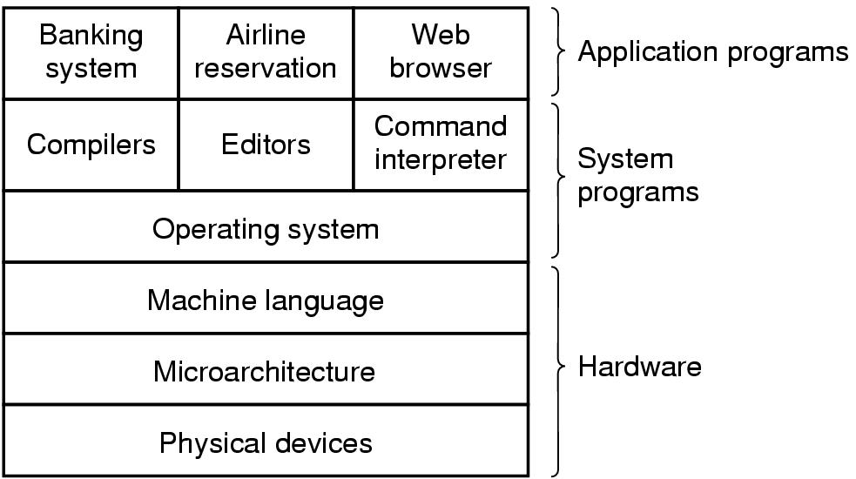
Components (Cont.)
A computer system consists of
  hardware
  system programs
  application programs

Slide 5
Components (Cont.)
  Hardware – provides basic computing resources
    CPU, memory, I/O devices
  Operating system
    Controls and coordinates use of hardware among various applications and users
  Application programs
    Define the ways in which the system resources are used to solve the computing problems of the users
      Word processors, compilers, web browsers, database systems, video games
  Users
    People, machines, other computers

Slide 6
What is an Operating System?
A program that acts as an intermediary between a user of a computer and the computer hardware.
Operating system goals:
  Execute user programs and make solving user problems easier.
  Make the computer system convenient to use.
Purpose:
  Use the computer hardware in an efficient manner.
OS is a resource allocator
  Manages all resources
  Decides between conflicting requests for efficient and fair resource use
OS is a control program
  Controls execution of programs to prevent errors and improper use of the computer

Slide 7
Operating System Definition (Cont.)
No universally accepted definition
An operating system (OS) is a collection of programs that achieve effective utilization of a computer system by providing
  Convenient methods of using a computer
  Efficient use of the computer
A modern OS supports different classes of users with diverse requirements
Each user has a different view of what an OS is, and what it does. Each of these views is called an abstract view

Slide 8
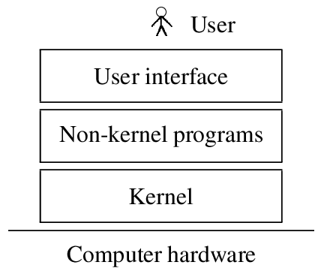
A designer's abstract view of an OS

Slide 9
A designer’s abstract view of an OS
The kernel programs : The one program running at all times on the computer” is the kernel. Everything else is either a system program (ships with the operating system) or an application program interact with the computer’s hardware and implement the intended operation
The non-kernel programs implement creation of programs and use of system resources by them. These programs use kernel programs to control operation of the computer
The user interface interprets the commands of a user and activates non-kernel programs to implement them

Slide 10
Goals of an OS
Two primary goals of an OS are
  Efficient use of the computer’s resources
    To ensure cost-effectiveness of the computer
  User convenience
    A user should find it easy to use the computer
These two goals sometimes conflict
  e.g. a user desires prompt service, which can be provided by not permitting other users to use the system simultaneously; however, efficient use requires sharing of a computer’s resources among many users
An OS designer decides which of the two goals is more important under what conditions.
  That is why we have so many operating systems!

Slide 11
User convenience
The computing environment is comprised of
  The computer system
  Its interfaces with other systems
  Nature of computations performed by its users
Computing environments change with the architecture and use of a computer, e.g. personal computing, interactive applications, embedded applications
Hence the notion of user convenience has several facets that depend on the computing environment

Slide 12
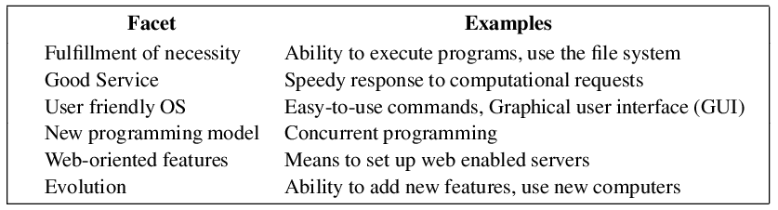
Facets of user convenience

Slide 13

Computer System Structure
Computer-system operation
  One or more CPUs, device controllers connect through common bus providing access to shared memory
  Concurrent execution of CPUs and devices competing for memory cycles

Slide 14
Operating System Functions?
Process Management
Main Memory Management
File Management
Storage Management
I/O System Management
Networking
Command Interpreter System
Protection and Security

Slide 15
Program management
A computational structure is a configuration of several programs. Three typical computational structures are:
  A single program
    Execution of a program on a given set of data
  A sequence of single program
    A program should be executed only if previous programs in the sequence executed successfully
    Programs should pass their results to other programs through files
  Co-executing programs
    The OS must execute these programs at the same time
    The OS must provide an interface between co-executing programs so that their results are available to one another

Slide 16
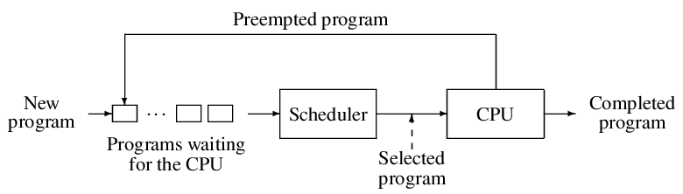
A schematic of scheduling

Slide 17
Process Management Activities
Create/delete both user and system processes
  Allocate/De-allocate resources (Memory and others…)
  Keep information of the processes
    Id, size, priority, start time, parent process, process group etc.
Suspend/resume processes
  Scheduling (will be discussed later in detail)
  Save/restore state→Context switch
    Registers, Program counter etc.

Slide 18
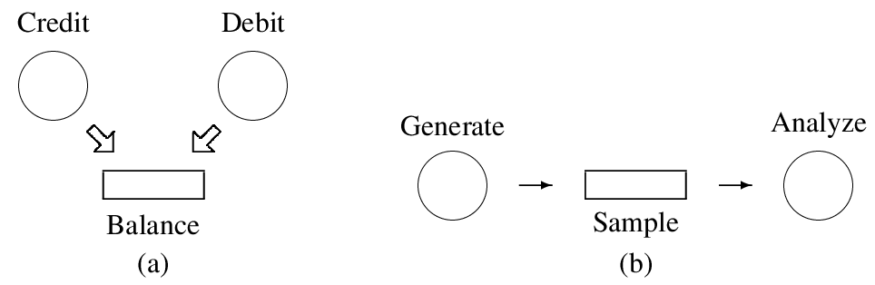
Process Management Activities (Contd.)
Provide mechanisms for process synchronization
  Data Sharing
    Only one process uses a shared data item or a resource at any time
  Process communication/coordination
    Processes must perform their operations in a desired order, e.g., if a process wishes to use some data produced by another process, it must read the data only after the other process has assigned a value to it

Slide 19
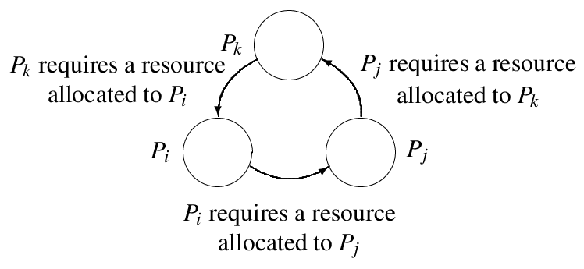
Process Management Activities (Contd.)
Provide mechanisms for deadlock handling

Slide 20
Resource management
Important criteria in resource management
  Resource utilization efficiency
    Share the resources wherever possible
    Avoid idling of resources
  Speed of resource allocation/de-allocation
Partitioning of resources
  A resource partition is a collection of resources
  A resource partition is allocated to a process
  Simplifies resources allocation and speeds it up
  Pros and cons?
Allocation from a pool
  Resources allocated individually when needed---Pros & cons?

Slide 21
Virtual resources
A virtual resource is an illusion presented to a program
  When a program performs an operation on a virtual resource, the operation is actually performed on a real resource
  Thus, a virtual resource is an abstraction; its implementation is hidden from a program
  An OS may use the same real device to support several virtual devices
Use of virtual resources simplifies resource allocation
  For example, virtual printers may be created if several programs need a printer each. This arrangement permits more programs to execute at the same time

Slide 22

Memory hierarchy
A large and fast memory would be expensive
The memory hierarchy is an arrangement of several memories with different access speeds and size

Slide 23
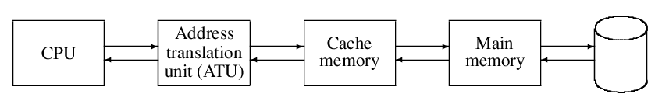
Caching
Important principle, performed at many levels in a computer (in hardware, operating system, software)
Information in use copied from slower to faster storage temporarily
Faster storage (cache) checked first to determine if information is there
  If it is, information used directly from the cache (fast)
  If not, data copied to cache and used there
    A `write-through’ arrangement is typically used to update memory

Slide 24
Caching
The cache hit ratio (h) indicates what percentage of accessed bytes were already present in memory
Effective memory access time =
h x access time of cache memory +
(1 – h) x (time to load a cache block + access time of cache memory)
Cache smaller than storage being cached
  Cache management important design problem
  Cache size and replacement policy

Slide 25
Memory Management
All data in memory before and after processing
All instructions in memory in order to execute
Memory management determines what is in memory when
  Optimizing CPU utilization and computer response to users
Memory management activities
  Keeping track of which parts of memory are currently being used and by whom
  Deciding which processes (or parts thereof) and data to move into and out of memory
  Allocating and deallocating memory space as needed

Slide 26
Storage Management
OS provides uniform, logical view of information storage
  Abstracts physical properties to logical storage unit - file
  Each medium is controlled by device (i.e., disk drive, tape drive)
    Varying properties include access speed, capacity, data-transfer rate, access method (sequential or random)
File-System management
  Files usually organized into directories
  Access control on most systems to determine who can access what
  OS activities include
    Creating and deleting files and directories
    Primitives to manipulate files and dirs
    Mapping files onto secondary storage
    Backup files onto stable (non-volatile) storage media

Slide 27
Mass-Storage Management
Usually disks used to store data that does not fit in main memory or data that must be kept for a “long” period of time.
Proper management is of central importance
Entire speed of computer operation hinges on disk subsystem and its algorithms
OS activities
  Free-space management
  Storage allocation
  Disk scheduling
Some storage need not be fast
  Tertiary storage includes optical storage, magnetic tape
  Still must be managed
  Varies between WORM (write-once, read-many-times) and RW (read-write)

Slide 28
Input/Output organization
Involvement of the CPU in I/O operations
  Should be the minimum due to mismatch of CPU and I/O speeds
  CPU should be free to execute instructions while I/O operations are in progress
Different I/O modes
  Programmed I/O
    CPU is involved
  Interrupt I/O
    CPU is partially involved
  Direct memory access (DMA)
    CPU is not involved

Slide 29
Input/Output organization
Hide peculiarities of hardware devices from the user
  General device-driver interface
  Drivers for specific hardware devices
buffering
  storing data temporarily while it is being transferred
caching
  storing parts of data in faster storage for performance
spooling
  the overlapping of output of one job with input of other jobs

Slide 30
Protection and Security
Protection – any mechanism for controlling access of processes or users to resources defined by the OS
Security – defense of the system against internal and external attacks
  Huge range, including denial-of-service, worms, viruses, identity theft, theft of service
Systems generally first distinguish among users, to determine who can do what
  User identities (user IDs, security IDs) include name and associated number, one per user
  User ID then associated with all files, processes of that user to determine access control
  Group identifier (group ID) allows set of users to be defined and controls managed, then also associated with each process, file
  Privilege escalation allows user to change to effective ID with more rights

Slide 31
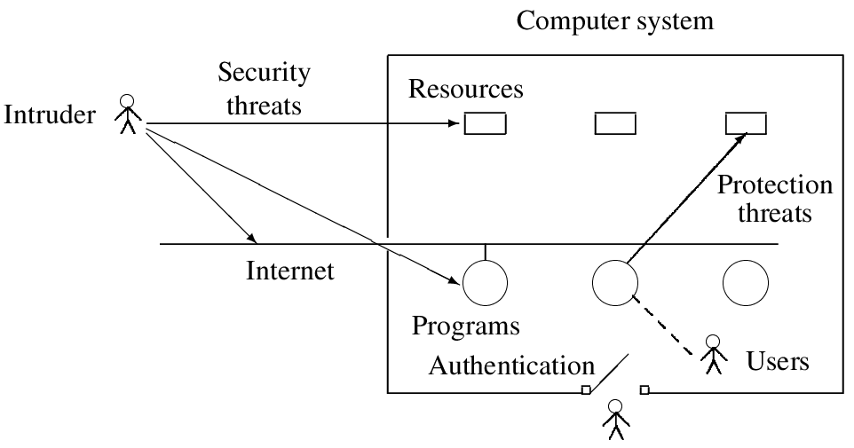
Overview of security and protection threats

